Slide 1
Embryonic Membranes and the Placenta

Slide 2
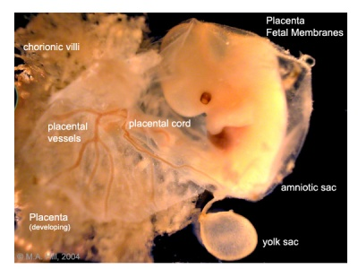

Slide 3
Placenta and Fetal Membranes
Amnion - Epiblast / Extraembryonic Mesoderm
Yolk Sac - Hypoblast / Extraembryonic Mesoderm
Allantois - Embryonic Hindgut
Chorion - Trophoblasts / Extraembryonic Mesoderm
Placenta - Chorion / Maternal Decidua

Slide 4
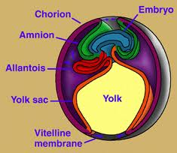

Slide 5
Amnion
Amnionic membrane is two cell layers
As the amnion enlarges it encompasses the embryo
Amnion forms the epithelial layer of the umbilical cord
With embryo growth the amnion obliterates the chorionic cavity
Amnionic sac is fluid filled called amnionic fluid: the
embryo is bathed in the fluid

Slide 6
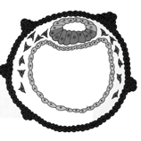
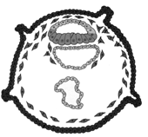
Extraembryonic Tissues
8 days
9 days
9 days
14days

Slide 9
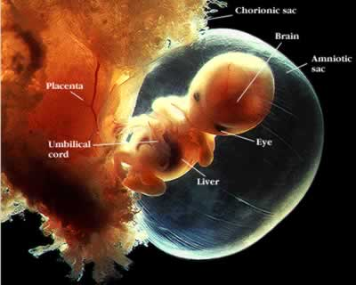

Slide 10
Amnion

Slide 11
Amniotic Fluid
Up to week 20 - fluid is similar to fetal serum (keratinization)
After 20 weeks – Contribution from urine, maternal serum filtered
thru endothelium of nearby vessels, filtration from fetal
vessels in cord
Near birth - can contain fetal feces called meconium
Near birth – amnionic fluid (500-1000 ml) exchanges every 3 hrs
1) across the amnion – exchange with maternal fluids.
2) fetal swallowing (20 ml/hour) – to gut – adsorption by
fetus – out the umbilical cord to placenta.
Hydraminos – Excess fluid (>2000 ml), esophageal atresia
Oligohydramnios – Insufficient fluid (<500 ml), renal agenesis

Slide 12
Amnion Function
Mechanical protection: hydrostatic pressure
Allows free movement - which aids in neuromuscular
development
Antibacterial
Allow for fetal growth
Protection from adhesions

Slide 13
Yolk Sac
Hypoblast - the primary yolk sac or Heuser's membrane.
Day 12 - Second wave of cell migration - forms definitive yolk sac
Early nutrition (2-3 weeks) for the embryo - later shrinking
Derivatives:
Primordial germ cells
The early gut, epithelium of the respiratory and digestive tracts

Slide 15
Allantois
Endodermal origin – caudal outpocketing of the yolk sac
Involved in early hematopoiesis
The allantois blood vessels - artery and vein – becomes the umbilical vessels
Remnants of Allantois becomes the urachus ligament that connects the belly button to the bladder

Slide 16
Chorion
Chorionic cavity (extraembryonic coelom)- lined with extraembryonic mesoderm
The Chorion / maternal endometrium forms the placenta
Chorion forms stem villi

Slide 17
Stem Villi

Slide 18
Stem Villi
Chorionic Plate – Stem villi extends from this tissue
Primary stem villi (day 11-13) - finger-like protrusions
into endometrium –
Secondary stem villi (day 16) - extraembryonic
mesoderm invasion into villi core.
Tertiary stem villus (21 day) - extraembryonic vessels
chorionic arteries and veins derived from
extraembryonic mesoderm.

Slide 19
Stem Villi
Cytotrophoblastic shell – surrounds embryo; direct contact with maternal decidual cells
Anchoring Villi – give off cytotrophoblastic extensions -
anchoring because they represent the real maternal embryo link
Floating Villi – branches off anchoring villi – dangles freely in maternal blood

Slide 20
Making the Placenta
By 8 weeks - chorionic stem villi over the entire surface of
the chorionic sac
Those villi increase in size and more villi form.
The villi continue to enlarge during most of gestation.
Endometrial vessels - spiral arteries and endometrial veins form

Slide 21
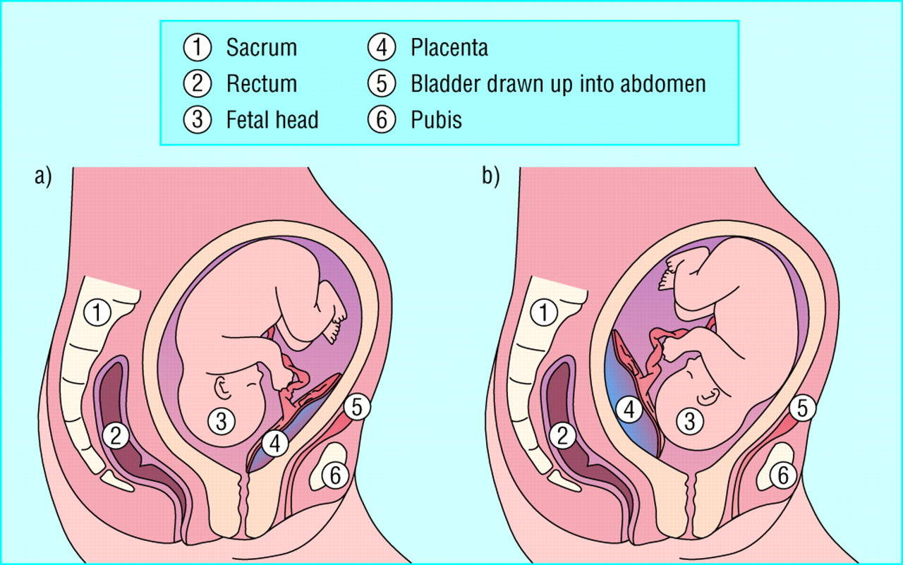

Slide 22
Placenta

Slide 23
Placental Blood Flow

Slide 24
Placental Anatomy

Slide 25
Umbilical Cord
One umbilical vein,
Two umbilical arteries
Wharton’s jelly –
connective tissue
surrounding vessels
Allantois
Yolk Stalk (vitelline duct)

Slide 26
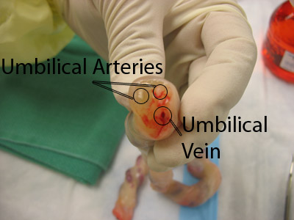

Slide 27
Placenta as an Endocrine Organ
Human Chorionic Gonadotropin – Corpus Luteum (declines after 8 weeks)
Progesterone – High levels by the end of first trimester
Estrogen – Synthesis involves enzymatic activity of fetal adrenal gland and liver
Chorionic Somatomammotropin – Human Placental Lactogen – similar to GH (growth, lactation, lipid and carbohydrate metabolism)
Placental Growth Hormone – similar to GH – Replaces maternal GH by 15 wks – enhances blood glucose levels

Slide 28
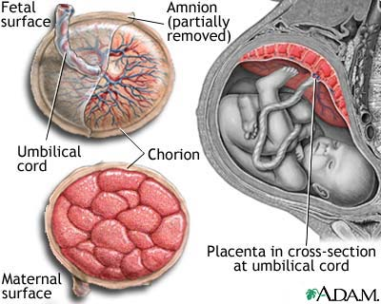

Slide 29
Should we look at a real one?

